Slide 1
Operating System and
System Programming
Software College of SCU
四川大学软件学院 左航

Slide 2
Unit 7: Performance Measurement
7.1 Rationale for this unit
7.2 Performance Principles
7.3 Performance Measurement
7.4 VC Profiler
201001V1.1

Slide 3
7.1 Rationale for this unit(1/4)
This unit is about Performance Measurement
  Next unit, we will focus on how to make programs run fast, that is optimizing program
201001V1.1

Slide 4
7.1 Rationale for this unit(2/4)
How to make the code faster
  First, we must find what should be optimized
    Bottlenecks瓶颈/Hot spots热点
201001V1.1

Slide 5

7.1 Rationale for this unit(3/4)
The Software Optimization Process
Hotspots are areas in your code that take a long time to execute
Create benchmark
Find hotspots
Retest using
benchmark
Investigate causes
Modify application
201001V1.1

Slide 6
7.1 Rationale for this unit(4/4)
CSAPP:
  How to get execute time
  What issues interfere us to get precise time
Slides : ssd6: 4
  Timers in computer system
  Practical ways to get execution time
201001V1.1

Slide 7
Unit 7: Performance Measurement
7.1 Rationale for this unit
7.2 Performance Principles
7.3 Performance Measurement
7.4 VC Profiler
201001V1.1

Slide 8
7.2 Performance Principles(1/5)
80/20 Rule – It means 80% of the CPU time is spent in 20% of the program.
In this case, you can have better performance by looking at this 20%.
201001V1.1

Slide 9
7.2 Performance Principles(2/5)
Amdahl’s Law(阿姆达尔法则) , also known as Amdahl's argument, is named after computer architect Gene Amdahl, and is used to find the maximum expected improvement to an overall system when only part of the system is improved. It is often used in parallel computing to predict the theoretical maximum speedup using multiple processors.
描述：系统优化某部件所获得的系统性能的改善程度，取决于该部件被使用的频率，或所占总执行时间的比例。
201001V1.1
Notes:
Amdahl定律告诉我们：系统中某一部件由于采用某种更快的执行方式后，整个系统性能的提高与
这种执行方式的使用频率或占总执行时间的比例有关。
Amdahl定律定义了由于采用特殊的方法所能获得的加速比的大小。

Slide 10
7.2 Performance Principles(3/5)
10% on one module means 2% as a whole
20 ms
20 ms
20 ms
18 ms
10%
98 ms
100 ms
20 ms
20 ms
20 ms
20 ms
20 ms
20 ms
201001V1.1

Slide 11
7.2 Performance Principles(4/5)
10% on one means 5% as a whole
Conclusion: focus on module with more CPU time
10 ms
10 ms
50 ms
45 ms
10%
95 ms
10 ms
10 ms
100 ms
10 ms
10 ms
10 ms
10 ms
201001V1.1

Slide 12

7.2 Performance Principles(5/5)
Speedup(due to EnhanceMent E)
S= ExcuteTime(without E) / ExcuteTime(With E)
= Performance(With E) / Performanc(Without E)
Suppose the enhancement E accelerates a fraction P of one task by a factor S and the remainder of the task unaffected then:
ExcuteTime(With E)
= {(1-P) + P/S}*ExcuteTime(Without E);
Speedup(E) =
201001V1.1
Notes:
ExcuteTime和Performance 可以看出周期和频率这种关系 假设原执行时间10，现在优化后是5，那么s=10/5=2;10分钟优化程序可以运行2次，而原程序1次，故为s=2/1
理论上S>1

Slide 13
Unit 7: Performance Measurement
7.1 Rationale for this unit
7.2 Performance Principles
7.3 Performance Measurement
7.4 VC Profiler
201001V1.1

Slide 14
7.3 Timing Mechanisms(1/16)
computers use two basic mechanisms to record the passage of time
  Low frequency: a low frequency timer that periodically interrupts the processor
  High frequency: a counter that is incremented every clock cycle.
201001V1.1

Slide 15
7.3 Timing Mechanisms(2/16)
Timer in Hardware E.g.: in IA32/ x86
晶振提供基准
时钟信号
外部晶振
实时时钟
(RTC)
Tick/时钟滴答: timer interval
定时/
计数器芯片
Intel8253
8259
中断
控制器
INTR
时间戳
记数器
TSC
CLK
201001V1.1
Notes:
8253具有3个独立的计数通道，采用减1计数方式。在门控信号有效时，每输入1个计数脉冲，通道作1次计数操作。当计数脉冲是已知周期的时钟信号时，计数就成为定时。
时钟芯片再以这个时钟频率为参考，在芯片内部进行一系列的倍频动 作，为主板提供系统所需的各式类型信号频率。
8253计数器0的输出端OUT0与8259的中断请求输入IRQ0相连，设定8253的计时时间为20ms，计时满后，8259产生一次时钟中断，然后调用时钟中断处理程序(time_interrupt)。
8259可以接入多种IO产生的中断
时间戳记数器TSC
从Pentium开始，所有的Intel 80x86 CPU就都又包含一个64位的时间戳记数器（TSC）的寄存器。该寄存器实际上是一个不断增加的计数器，它在CPU的每个时钟信号到来时加1（也即每一个clock-cycle输入CPU时，该计数器的值就加1）。
汇编指令rdtsc可以用于读取TSC的值。利用CPU的TSC，操作系统通常可以得到更为精准的时间度量。假如clock-cycle的频率是400MHZ，那么TSC就将每2.5纳秒增加一次。

Slide 16
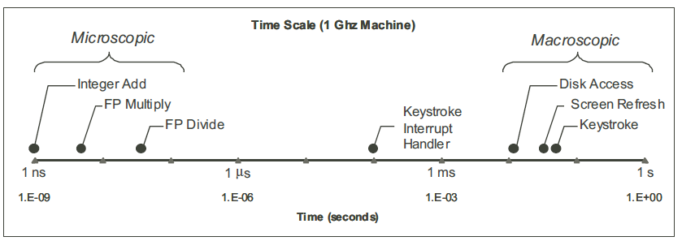
7.3 Timing Mechanisms(3/16)
The processor works at a microscopic time scale :nanoseconds (ns).
The OS must deal on a macroscopic time scale : milliseconds (ms).
Time Scale of Computer System Events.
201001V1.1

Slide 17
7.3 Timing Mechanisms(4/16)
OS: interval time (本次实验内容）
  an external timer periodically generates an interrupt signal to the processor
  keystrokes, disk operations, network activity generate interrupt signals, Process Scheduling
201001V1.1

Slide 18
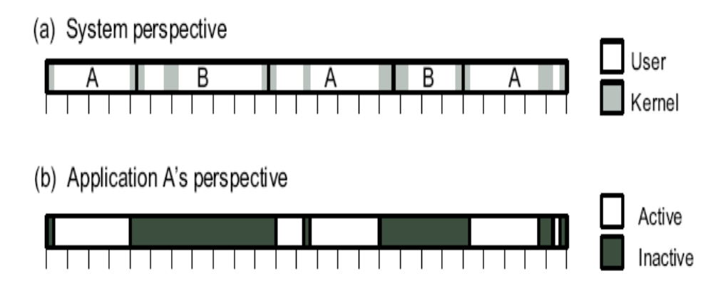
7.3 Timing Mechanisms(5/16)
  Wall Time (时钟时间指从A开始到A结束）
  CPU Time （CPU时间指花费在A进程上的时间，即处于A激活状态时的时间总和）
201001V1.1

Slide 19
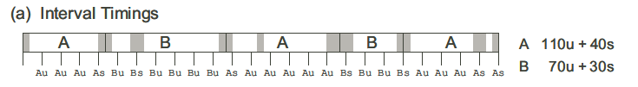
7.3 Timing Mechanisms(6/16)
1. Process Timing by Interval Counting. （程序CPU时间）
  With a timer interval of 10 ms, every 10 ms segment is assigned to a process as part of either its user (u) or system (s) time. This accounting provides only an approximate measure of program execution time.
  对执行时间短的进程，测量误差过大
201001V1.1
Notes:
C

Slide 20
7.3 Timing Mechanisms(7/16)
2. Reading the Process Timers （程序wall time）
  Call time functions provided by OS
  times returns the total number of clock ticks that have elapsed since the system was started.
  compute the total time (in clock ticks) between two different points by making two calls to times and computing the difference of the return values.
  ANSI C standard
#include <time.h>
clock t clock(void);
201001V1.1
Notes:
Prog进程名字 -n 17 为进程参数

Slide 21
7.3 Timing Mechanisms(8/16)
3. Measuring with Cycle Counters （程序wall time）
  Time stamp counter ：High precise
  Intel Pentium processors (among others) ：high-speed internal 64-bit counter that can be accessed by special instructions. (Windows operating systems have an interface )
  把两次的TSC差值除以两次的时间差值就是CPU的主频
  TSC的精度和硬件相关
measuring the time that elapses between two different points
  do not keep track of which process uses those cycles or whether the processor is operating in kernel or user mode.
201001V1.1

Slide 22
7.3 Timing Mechanisms(9/16)
clock()
  clock_t clock( void );
  Required header <time.h>
    CLOCKS_PER_SEC defined in time.h
  Return Value: clock returns the number of processor timer ticks that have elapsed.
  Remarks:
    The clock function tells how much processor time the calling process has used.
    The time in seconds is approximated by dividing the clock return value by the value of the CLOCKS_PER_SEC constant.
    A timer tick is approximately equal to 1/CLOCKS_PER_SEC second.
201001V1.1
Notes:
clock()函数并不测定实际时间，而是测定CPU执行时间，如果要把两个clock()调用之间的时间间隔转换为秒，需要把它们的差除以CLOCK_PER_SEC。这样测试精确度可以达到毫秒级。
在time.h文件中，还定义了一个常量CLOCKS_PER_SEC
每过千分之一秒（1毫秒），调用clock（）函数返回的值就加1
因此clock（）返回值精确到毫秒。要知道是多少秒，需要除以1000，即CLOCKS_PER_SEC
这个函数返回从“开启这个程序进程”到“程序中调用clock()函数”时之间的CPU时钟计时单元（clock tick）数

Slide 23
7.3 Timing Mechanisms(10/16)
#include <stdlib.h>
#include <time.h>
#include <iostream.h>
void my_subroutine(long n) {
// timing a subroutine call:
char s[16];
for (long i = 0; i < n; i++) {
_itoa(i, s, sizeof(s));
}
}
clock() in C/C++
int main(int argc, char* argv[]) {
long n = 1000000;
clock_t start = clock();
my_subroutine(n);
clock_t finish = clock();
double duration = (double)(finish - start) / CLOCKS_PER_SEC;
cout << "Time for " << n << " iterations: " << duration << "s,"
<< " precision is " << CLOCKS_PER_SEC
<< " clocks per second." << endl;
return 0;
}
201001V1.1

Slide 24
7.3 Timing Mechanisms(11/16)
High-Resolution Timer Function (Win32API)
  The QueryPerformanceFrequency() function retrieves the frequency of the high-resolution performance counter, if one exists.
  BOOL QueryPerformanceFrequency (
  LARGE_INTEGER* lpFrequency
  // address of current frequency );
  返回值：非零，硬件支持高精度计数器；零，硬件不支持，读取失败。
201001V1.1

Slide 25
7.3 Timing Mechanisms(12/16)
High-Resolution Timer Function (Win32API )
  The QueryPerformanceCounter() function retrieves the current value of the high-resolution performance counter, if one exists.
  BOOL QueryPerformanceCounter(
  LARGE_INTEGER *lpPerformanceCount
  // pointer to counter value );
201001V1.1

Slide 26
7.3 Timing Mechanisms(13/16)
LARGE_INTEGER
  The LARGE_INTEGER structure is used to represent a 64-bit signed integer value.
  If your compiler has built-in support for 64-bit integers, use the QuadPart member to store the 64-bit integer.
  Otherwise, use the LowPart and HighPart members to store the 64-bit integer.
typedef union _LARGE_INTEGER {
  struct {
    DWORD LowPart;
    LONG HighPart;
  };
  LONGLONG QuadPart;
} LARGE_INTEGER;
201001V1.1

Slide 27
7.3 Timing Mechanisms(14/16)
LARGE_INTEGER litmp;
LONGLONG QPart1,QPart2;
double dfFreq;
double dfMinus, dfTim;
QueryPerformanceFrequency(&litmp);
dfFreq = (double)litmp.QuadPart;// 获得计数器的时钟频率
QueryPerformanceCounter(&litmp);
QPart1 = litmp.QuadPart;// 获得初始值
Sleep(100); //milliseconds
QueryPerformanceCounter(&litmp);
QPart2 = litmp.QuadPart;//获得中止值
dfMinus = (double)(QPart2-QPart1);
dfTim = dfMinus / dfFreq;// 获得对应的时间值，单位为秒
201001V1.1
Ref：http://www.vckbase.com/document/viewdoc/?id=1301 VC中基于 Windows 的精确定时

Slide 28
7.3 Timing Mechanisms(15/16)
Effects factor of measurement
  System load系统负载
  Context Switching进程切换
  Cold cache problem
  may overestimates of the true execution time
    Measurements of Long Duration Procedure on a lightly loaded system, the results are consistent across samples, but on a heavily loaded system, many of the measurements overestimate the true execution time.
201001V1.1

Slide 29
7.3 Timing Mechanisms(16/16)
1. light loaded system
2. measure k times
3. If we find these measurements agree within
some small tolerance (e.g., 0.1%), it seems reasonable that the fastest of these represents the true execution time of the procedure
201001V1.1
Notes:
计算机性能评测可以与体系结构、系统软件和算法并称为计算科学的四大组成部分。
在用户选购计算机的关口，在厂商盼望其产品金榜题名的时候，性能评测总是倍受关注，眼花缭乱的性能指标被炒得沸沸扬扬。

Slide 30
Unit 7: Performance Measurement
7.1 Rationale for this unit
7.2 Performance Principles
7.3 Performance Measurement
7.4 VC Profiler
201001V1.1

Slide 31
7.4.1 Statistical Sampling/Profiling(1/3)
In this approach, a timer periodically interrupts the program and records the program counter
This approach can only estimate where time is spent in the program.
Fortunately, if the program spends most of its time in a few places, these are almost certain to be identified and accurately measured.
201001V1.1

Slide 32
7.4.1 Statistical Sampling/Profiling(2/3)
Software profiler - a program that benchmarks the execution of one or more pieces of procedural code to help the user understand where the time is being spent in terms of code execution.
  Gprof
  VTune
  Visual Studio/Visual C++ Profiler
  IBM Quantify
201001V1.1

Slide 33
7.4.1 Statistical Sampling/Profiling(3/3)
WINDOWS下免费的性能分析工具：
  Very Sleepy ： http://www.codersnotes.com/sleepy/sleepy
  Luke Stackwalker ：http://lukestackwalker.sourceforge.net/
  Shiny： http://sourceforge.net/projects/shinyprofiler/
  VSPTree： http://code.google.com/p/vsptree/
  Timing：http://ravenspoint.wordpress.com/2010/06/16/timing/
201001V1.1

Slide 34
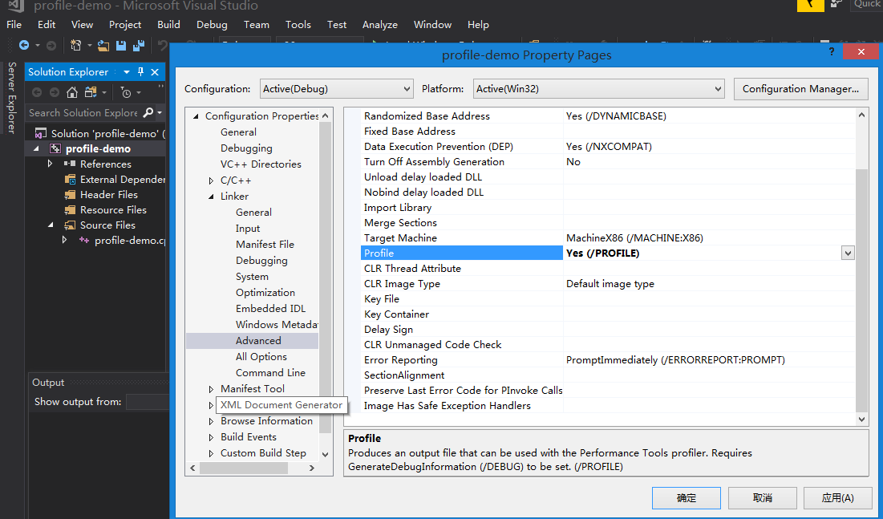
7.4.2 VS Profiler (1/5)
More detail on profiling_lab.doc
Enable profile in VS 2017: set project property
201001V1.1

Slide 35
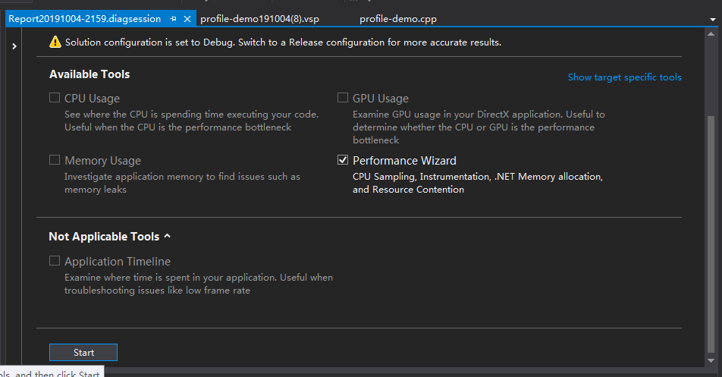
7.4.2 VS Profiler (1/5)
“Debug”->”Profiler”->”performance profiler”. In the pop window click “Performance Wizard” then start”.
201001V1.1

Slide 36

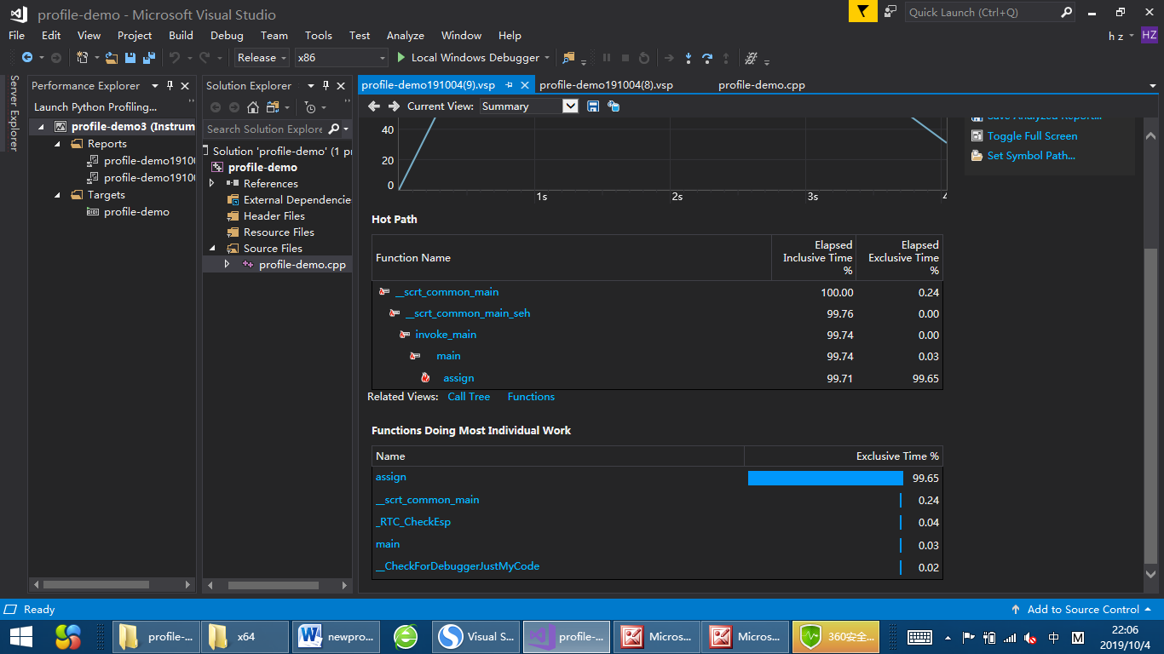
7.4.2 VS Profiler (3/5)
float a[10000];
void assign(int i) {
int j;
for (j = 0; j <10000; j++)
a[i] = a[j];
}
void main() {
int i;
for (i = 0; i <10000; i++)
a[i] =1.0;
for (i = 0; i < 10000; i++)
assign(i);
}
201001V1.1

Slide 37
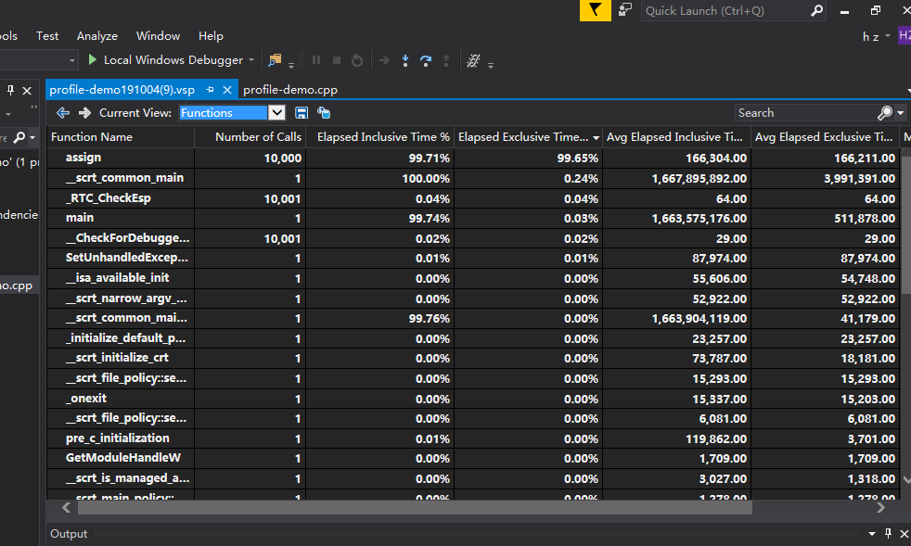
7.4.2 VS Profiler (4/5)
201001V1.1

Slide 38
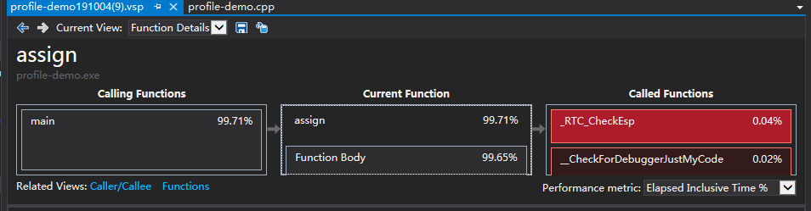
7.4.2 VS Profiler (5/5)
201001V1.1

Slide 39
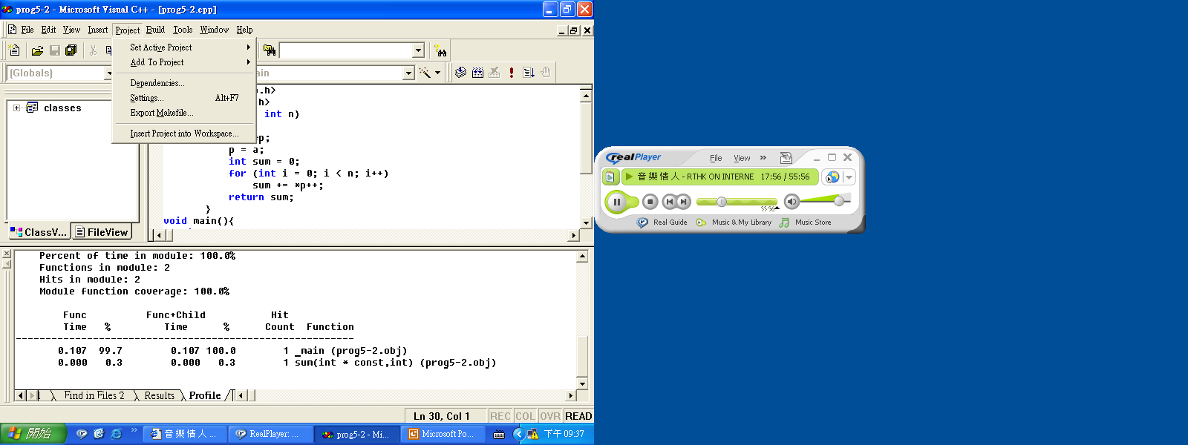
7.4.3 VC Profiler (1/18)
Procedure (1) – setting
201001V1.1

Slide 40
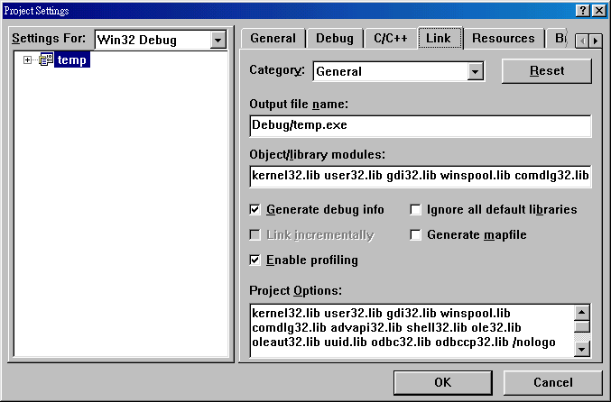
7.4.3 VC Profiler (2/18)
Procedure (2) – enable profiling
201001V1.1

Slide 41
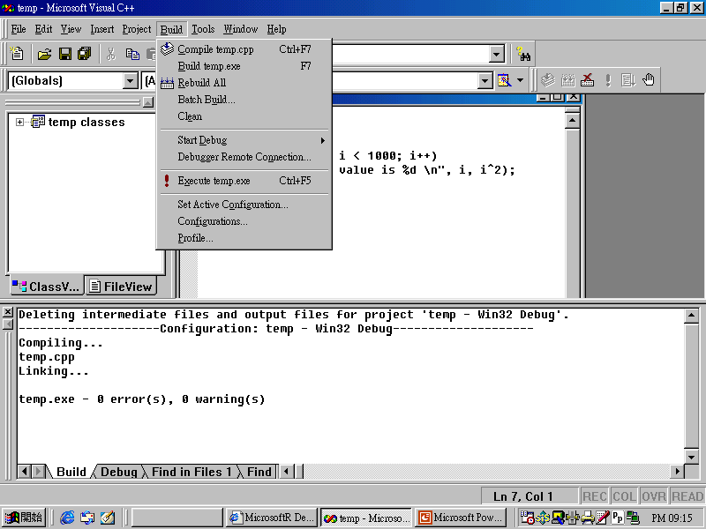
7.4.3 VC Profiler (3/18)
Procedure (3) – rebuild
201001V1.1

Slide 42
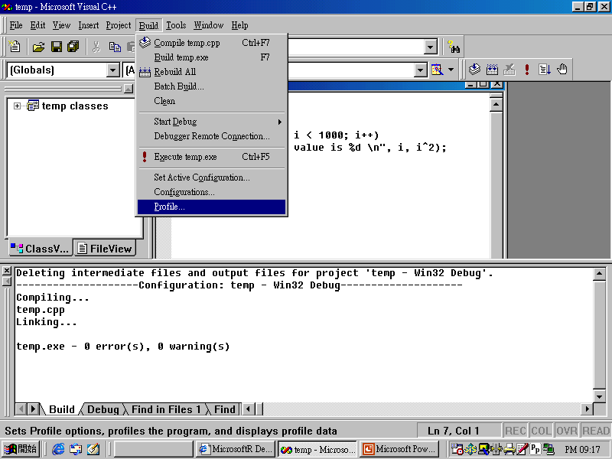
7.4.3 VC Profiler (4/18)
Procedure (4) – run with profiling
201001V1.1

Slide 43
7.4.3 VC Profiler (5/18)
#include <stdio.h>
#include <stdlib.h>
void main()
{
int I;
for (i = 0; i < 1000; i++)
printf("The value is %d\t %d \n", i, i*i);
}
201001V1.1

Slide 44
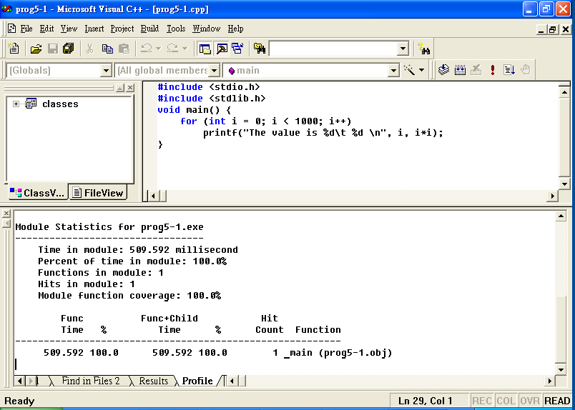
7.4.3 VC Profiler (6/18)
Result of a simple for loop – total time is 509 ms
201001V1.1

Slide 45
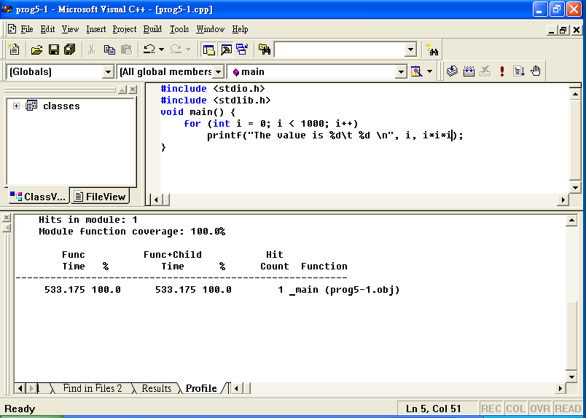
7.4.3 VC Profiler (7/18)
Result of a simple for loop – total time is 533 ms
201001V1.1

Slide 46
7.4.3 VC Profiler (8/18)
#include <stdio.h>
#include <stdlib.h>
void main() {
int i = 0;
while (i < 1000) {
printf("The value is %d\t %d \n", i, i*i);
i++;
}
}
201001V1.1

Slide 47
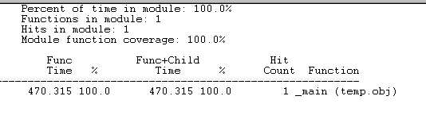
7.4.3 VC Profiler (9/18)
Example – result in millisecond second
201001V1.1

Slide 48
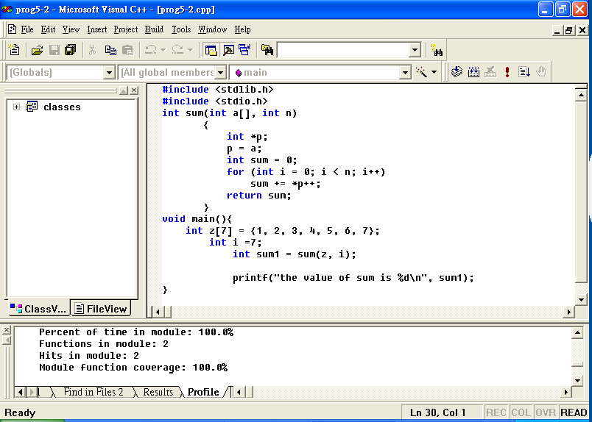
7.4.3 VC Profiler (10/18)
Example with a sub-routine函数
201001V1.1

Slide 49
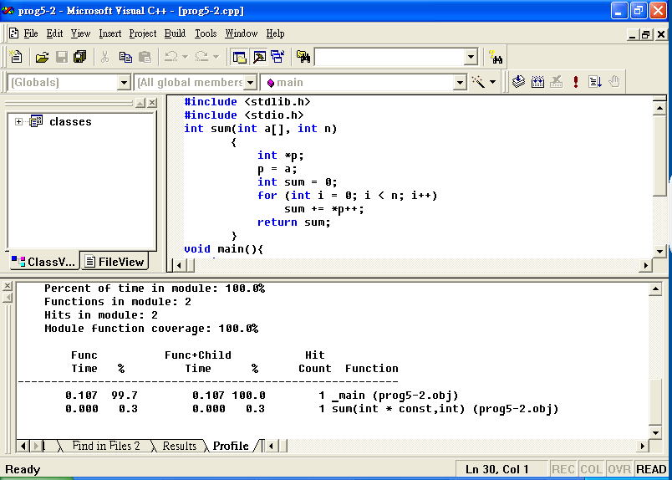
7.4.3 VC Profiler (11/18)
Example with a sub-routine
Main()
subroutine
201001V1.1

Slide 50
7.4.3 VC Profiler (12/18)
A program that can be used to determine MFLOP
  (million floating point operations per second)
// This is matrix multiplication
#include <stdio.h>
#include <stdlib.h>
void main(){
float a[250][250], b[250][250], c[250][250];
int i, j, k;
for (i = 0; i< 250; i++)
for (j = 0; j < 250; j++)
for (k =0; k <250; k++)
// matrix multiplication
c[i][j] += a[i][k] * b[k][j];
}
201001V1.1
Notes:
浮点的存储，一个是浮点加，一个是浮点乘

Slide 51
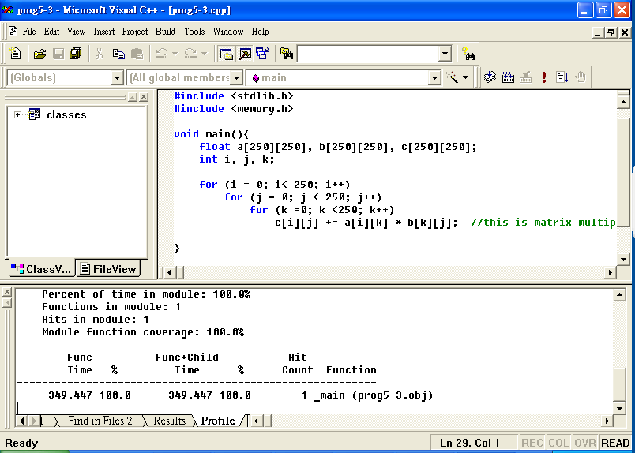
7.4.3 VC Profiler (13/18)
Performance is 349ms
201001V1.1

Slide 52
7.4.3 VC Profiler (14/18)
Determination of Mega Flop
  The time it takes for my machine is 349ms.
  This program involves 250^3 steps including two floating point operations, an add and a multiply 250 x 250 x 250 = 15625000.
  The performance for this loop is 15625000/349ms = 15.625 x 10^6 /0.349 s = 44 MFLOPs (mega floating point operation).
  Note that for super computer, the value is about 1000 MFLOPs.
  You can try your computer at lab to determine your machine’s performance.
201001V1.1
Notes:
计算机早期的性能评估指标是MIPS，表示每秒能执行的指令条数。不论是Mflop/s，还是PDR，都是一种逻辑的推算，含有“拍脑袋”的成分，难以让人真正信服。

Slide 53
7.4.3 VC Profiler (15/18)
Same output but change the program
#include <stdio.h>
#include <stdlib.h>
// this program uses a temporary location t to store the value
void main() {
float a[250][250], b[250][250], c[250][250];
int i, j, k;
float r = 0.0;
for (i = 0; i< 250; i++) {
for (j = 0; j < 250; j++) {
for (k =0; k <250; k++)
r += a[i][k] * b[k][j]; //this is matrix multiplication
c[i][j] = r;
}
} }
201001V1.1

Slide 54
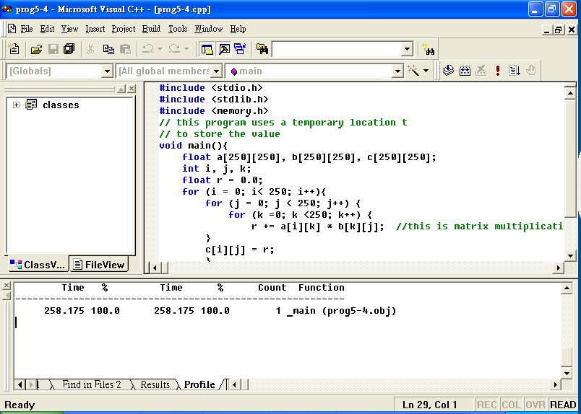
7.4.3 VC Profiler (16/18)
Same machine – 258ms, why?
This is related to the cache memory effect, as the data is stored in cache. This will be explained later.
201001V1.1

Slide 55
7.4.3 VC Profiler (17/18)
A profiler can:
  measure the elapsed time taken to run source code
  Provide coverage analysis
  Show program’s execution history
  How many times a piece of code has been exec.
  Time spent by all exec. of that piece of code
It is a great way to find where bottlenecks occur, so we can make our code more efficient
201001V1.1

Slide 56
7.4.3 VC Profiler (18/18)
Profiling is used to help programmers to identify
  which areas of the program are causing sluggish(迟缓) bottlenecks.
  which parts of the code are being called the most often.
201001V1.1

Slide 57
Additon on CSAPP(1/2)
Why not easy to get precise time?
  Overhead(高速缓存、磁盘)
  System load 负载(进程切换等)
201001V1.1

Slide 58
Additon on CSAPP(2/2)
If the anticipated run times of X are long (e.g., greater than 1.0 second), USE interval counting : less sensitive to processor load. 间隔计数
If the anticipated run times of X are in a range of around 0.01 to 1.0 seconds, then it is essential to perform measurements on a lightly loaded system, and to use accurate, cycle-based timing. 时间戳
If the anticipated run times of X are less than around 0.01 second, then accurate measurements can be performed even on a heavily loaded system, as long as it uses cycle-based timing.时间戳
201001V1.1

